Slide 1
Using Google’s PageRank Model to Rank Sports Teams
Kenneth Nakazawa
Columbia University
Applied Math 4903
4/23/14

Slide 2

About Me, Why I am Interested
I have always enjoyed playing and watching sports, although I am not necessarily good at any particular one. I very frequently visit ESPN and other sports websites to keep updated. Math is a hard subject, so I wanted to focus on a topic that conceptually makes sense to me.
Post-graduation plans: medical school in the fall (Mount Sinai)
Images: Someecards.com

Slide 3
References
Primary Paper:
[Govan et al. 2008] A. Y. Govan, C. D. Meyer, and R. Albright, “Generalizing Google’s PageRank to rank National Football League teams”, in Proceedings of the SAS Global Forum, SAS Global Users Group/SAS Institute, Cary, NC, 2008.
Secondary Resources:
[Bryan et al. 2006] K. Bryant and T. Leise, “The $25,000,000,000 Eigenvector: The Linear Algebra behind Google”, in SIAM Review, Vol. 48, No. 3., 2006.
[Colley 2002] W. N. Colley, Colley’s Bias Free College Football Ranking Method, 30 May 2002, Colley Matrix, accessed on 21 Apr. 2014 <http://www.colleyrankings.com/method.html>
[Meyer 2005] Carl D. Meyer Matrix Analysis and Applied Linear Algebra, SIAM, Philadelphia, 2005.
[Chris Thoung 2012] C. Thoung, “Chelsea deserve a place in next season’s UEFA Champions League,” in Cambridge Econometrics, 18 May 2012, accessed on 21 Apr. 2014 <http://www.camecon.com/Libraries/Downloadable_Files/ CE_UEFA_CL_Chelsea.sflb.ashx>
Notes:
Chelsea deserve a place in next season’s
UEFA Champions League

Slide 4
Presentation Overview
Sports rankings
Google PageRank model
Applying the PageRank model to sports
Notes:
Applying the PageRank Model to Sports Teams

Slide 5
Why Do People Care About Sports Rankings?

Slide 6
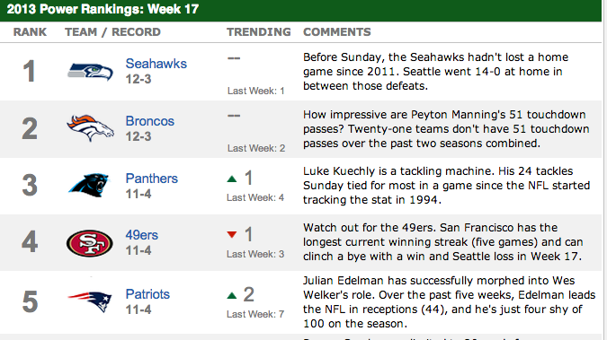
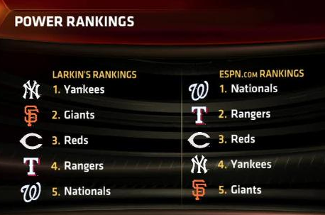


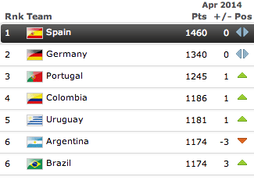

Images: ESPN.com, FIFA.com, Wikipedia.org
Notes:
Image citations: ESPN.com, FIFA.com, Wikipedia. (will add citations later)

Slide 7

Why Care About Sports Rankings?
Sports is an important part of culture and media
Fans are competitive and like to be “right”:
“The Red Sox are better than the Yankees” (said no one ever)
“The Jets will win the Super Bowl” (said no one ever)
“(Insert comment about the Knicks)” (Spike Lee)
Sports betting is a huge industry:
In 2011, $3.2 billion was wagered in sports bets in state casinos (Nevada Gaming Commission)
Between $60-70 billion is illegally wagered on college football annually (CNBC)
33 million Americans participated in Fantasy Football (Fantasy Sports Trade Association)
Images: Google Images

Slide 8


Google’s PageRank
An algorithm used by Google Search to rank websites in their search engine results (Wikipedia)
Developed by Larry Page and Sergey Brin at Stanford University in 1996
Images: Google.com (T), The Guardian, 2009 (B)

Slide 9

Basic Principle Behind PageRank
Images: Wikipedia.org
To determine a website’s importance, count the number of hyperlinks pointing to the site, with more weight given to hyperlinks coming from other important sites
Underlying Assumption:
Important websites are likely to receive more links from other sites.
Notes:
Cartoon illustrating basic principle of PageRank. The size of each face is proportional to the total size of the other faces which are pointing to it.

Slide 10
PageRank’s Strategy (Conceptually)
When one page links to another, it casts a “vote” to that webpage.
More votes → higher importance
Votes coming from more important websites have more importance
PageRank takes into account the number of votes and the importance of those votes in determining the site’s overall importance
The Google search engine uses the importance of a website as one of its factors in determining the final page rankings in its results

Slide 11
PageRank’s Strategy (Mathematically)
Express the web as a directed graph/Internet matrix H
If there is a link from page i to j , H_{ij} = 1/(outdegree of the i^{th} webpage)
Else, H_{ij} = 0
Alter H so that it is a stochastic (transition) matrix S
Artificially create links from a dangling node to every other page
i.e. convert all zero rows to rows with entries equal to 1/n
Adjust S to make an irreducible, stochastic matrix G
Add artificial links from every page to every other one
G= αS + (1-α)E
Perform the Markov chain process to compute the final rank vector:
z∞ = lim_{k→∞} z₀G^{k} = π

Slide 12
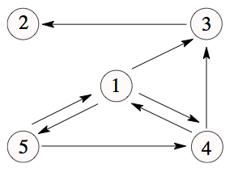
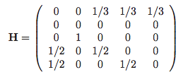
Construct the Internet Graph/Matrix (H)
Each webpage is a node
The directed edges represent hyperlinks between webpages
Out-degree = the number of links pointing out from a node
e.g. Webpage 1 (P₁) has a link to webpage 3, 4, and 5, so the out-degree = 3
If there is a link from page i to j , H_{ij} = 1/(outdegree of the i^{th} webpage)
Else, H_{ij} = 0
Images: Govan et al. 2008

Slide 13


Rank of a Web Page via Markov Chain
r(P) = rank of the webpage
B_{P} = set of all pages pointing to P
Q = outdegree of webpage Q
r_{k+1}(P) = rank of the webpage
after k+1 iterations
We can express our webpage rankings in a rank vector (z)
z₀ = [ r₀(P₁) r₀(P₂) r₀(P₃) r₀(P₄) r₀(P₅) ]
= [1/5 1/5 1/5 1/5 1/5]
z₀ is our initial vector w/ each entry as the initial page rank of each site. In this case, every site is of equal importance at first (1/n).
z₁ = [ r₁(P₁) r₁(P₂) r₁(P₃) r₁(P₄) r₁(P₅) ]
= [1/5 1/5 1/6 1/6 1/15]
(Keep iterating)
z∞ = [ r∞ (P₁) r∞ (P₂) r∞ (P₃) r∞ (P₄) r∞ (P₅) ]
Images: Govan et al. 2008

Slide 14
Rank of a Web Page via Markov Chain
Once we convert our original matrix H to an irreducible, stochastic matrix G, we can compute a Markov chain:
z₁ = z₀G
z₂ = z₁G
H may not guarantee the existence and uniqueness of π, so we need to make adjustments to H (H → G)
We can write the iterative procedure as:
z_{k+1} = z_{k}G, k = 0, 1, 2, …, ∞
Or equivalently:
z_{k} = z₀G^{k}, k = 0, 1, 2, 3, …, ∞
We eventually hope to find the final rank vector (π):
lim_{k→ ∞} z₀G^{k} = π

Slide 15
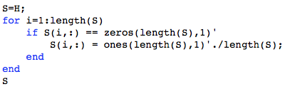
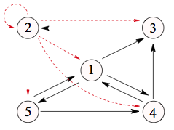
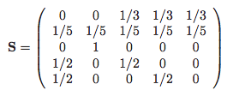
Internet Stochastic Matrix (S)
(Right) Stochastic Matrix: Nonnegative entries w/ each row summing to 1
The zero row in H corresponds to P₂, a dangling node (a webpage with no links to other pages)
A simple adjustment is converting the zero row to a row with entries equal to 1/n
Artificially creating links from
the dangling node to every other page
(using the URL to type in a random address)
Code: Kenny; Images: Govan et al. 2008

Slide 16
Irreducible Stochastic Matrix
An irreducible matrix represents a graph that is strongly connected, that is, every node is reachable from every other node (Govan et al. 2008)
An irreducible, stochastic matrix is necessary because then by the Perron-Frobenius Theorem, we insure the convergence of the iterative process → guarantees the existence of the final rank vector π
z∞ = lim_{k→ ∞} z₀G^{k} = π
The original graph was not strongly connected
Images: Govan et al. 2008

Slide 17
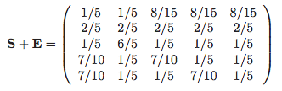
Irreducible Stochastic Matrix
To make S irreducible, add artificial links from every page to every other page by adding a new matrix E of all 1/n to S (i.e. the ability to type any possible random webpage URL)
E = ev^{T}
e = column of all ones
v = personalization vector [0.2 0.2 0.2 0.2 0.2]
But now S+E is not stochastic (sum of each row is not 1), so we need to adjust again...
Images: Govan et al. 2008
Notes:
Citations

Slide 18
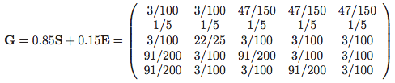
Google Matrix (G)
Create an irreducible, stochastic matrix G from S+E by adjusting it:
G= αS + (1-α)E, where α ε (0,1)
We can think of α = 0.85 as following the hyperlink structure 85% of the time and “teleporting” 15% of the time
Now we want to solve:
lim_{k→ ∞} z₀G^{k} = π
(where the i^{th} entry of π is the PageRank of webpage P_{i})
Images: Govan et al. 2008

Slide 19
Perron-Frobenius Theorem (PFT)
Any irreducible, (aperiodic), stochastic matrix G has an eigenvalue |λ₁| = 1. Moreover, all other eigenvalues λ_{i} of G satisfy |λ_{i}| < 1.
i.e. |λ₁| = 1 > |λ_{i}| for i = 2, … , n
The following limit exists and is unique according to PFT:
lim_{k→ ∞} z₀G^{k} = π
(where the i^{th} entry of π is the PageRank of webpage P_{i})

Slide 20
Use PFT to Solve lim_{k→∞} z₀G^{k} = π
Let V = [v₁ … v_{n}], where v_{i} = eigenvectors of G^{T}
z₀^{T} = Vc, where c = col. vector of coefficients, [c₁ … c_{n}]^{T}, (c₁ ≠ 0)
= c₁v₁ + … + c_{n}v_{n}
------------------------------------------------------------------------------------
(z₀G)^{T} = G^{T}z₀^{T}
G^{T} z₀^{T} = (G^{T} ) [c₁v₁ + c₂v₂ + … + c_{n}v_{n}]
= c₁(G^{T} v₁) + c₂(G^{T} v₂) + … + c_{n}(G^{T} v_{n})
= c₁(λ₁v₁) + c₂(λ₂v₂) + … + c_{n}(λ_{n}v_{n})
------------------------------------------------------------------------------------
lim_{k→ ∞} (G^{T} )^{k} z₀^{T} = c₁(λ₁^{k} v₁) + c₂(λ₂^{k} v₂) + … + c_{n}(λ_{n}^{k}v_{n})
= λ₁^{k} [c₁v₁ + c₂ (λ₂/λ₁)^{k} v₂ + … +c_{n} (λ_{n}/λ₁)^{k} v_{n}
Because G is irreducible and stochastic, by the Perron-Frobenius Theorem:
(λ₂/λ₁), (λ₃/λ₁), … , (λ_{n}/λ₁) < 1 since |λ₁| = 1 > |λ₂| > |λ₃| > … > |λ_{n}|
(λ₂/λ₁)^{k} , (λ₃/λ₁)^{k}, … , (λ_{n}/λ₁)^{k} → 0 as k → ∞
Thus,
lim_{k→∞} z₀G^{k} ≈ c₁v₁ = π
Notes:
“My chalk”
An aside: This is an alternative method to raising G to ∞, which you can’t do numerically. Raising G to a large number would be an easy approximation.

Slide 21

PageRank Vector (π)
z₀ = [0.2 0.2 0.2 0.2 0.2]
lim_{k→ ∞} z₀G^{k} = c₁v₁ = π
(where π is the ranking vector)
G =
0.0300 0.0300 0.3133 0.3133 0.3133 0.2000 0.2000 0.2000 0.2000 0.2000 0.0300 0.8800 0.0300 0.0300 0.0300 0.4550 0.0300 0.4550 0.0300 0.0300 0.4550 0.0300 0.0300 0.4550 0.0300
PageRankValues (π) ≈
0.2102 0.2545 0.2132 0.1893 0.1328
webpage_ranking_high_to_low =
P₂ P₃ P₁ P₄ P₅
I used the “eig(G)” MATLAB function, but there are other approaches to finding the left eigenvalue associated with λ = 1
Refer to Google.m file

Slide 22
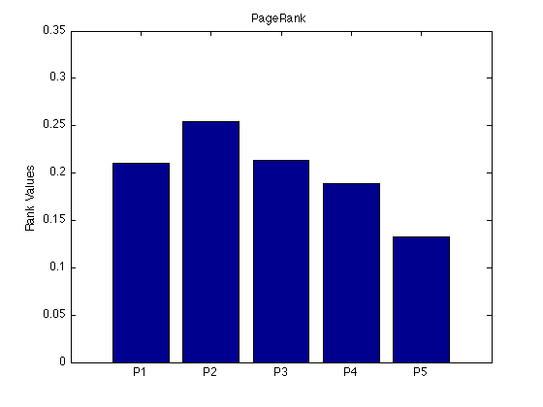
α = 0.85
Webpage Ranking=
P₂ P₃ P₁ P₄ P₅
Refer to Google.m file
Images: Govan et al. 2008

Slide 23
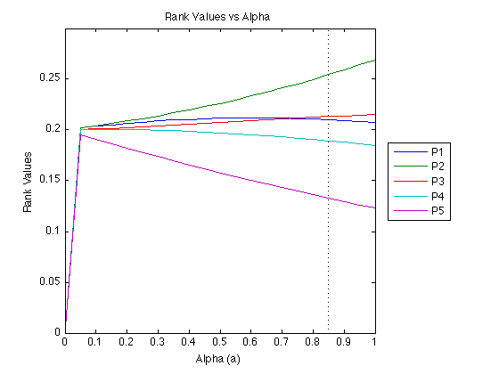
Refer to Google_alpha.m file

Slide 24
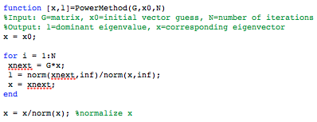
Remark: The $25 Billion Eigenvector
Bryan et. al 2006
I used the eig( ) MATLAB function to compute all the eigenvalues and eigenvectors of G for my subsequent calculation of the final rank vector π
Given the size of the Internet, such an approach is inefficient.
There are other methods for computing just the left eigenvector associated with the dominant eigenvalue λ = 1:
Power Method
Meyer 2005, pg 534
Advantage: Computationally efficient for large matrices
Disadvantage:
Only computes dominant λ and its eigenvector
Refer to PowerMethod.m and test_PM files
Code: Kenny

Slide 25
Applying the PageRank Model to Sports Teams

Slide 26
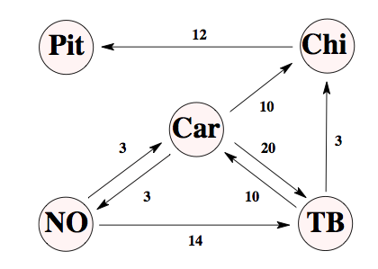
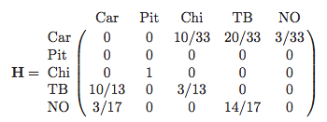

Constructing the NFL Graph/Matrix
Each team is a node
The direction of the edge is from loser to the winner
The weight of each link is the positive score difference:
e.g. Pitt beats Chi 21-9, so the weight is 12
This is analogous to a losing team casting a # of “votes” in favor of the winning team
W_{ij} = the weight of the edge from team i to team j
Images: Govan et al. 2008
Notes:
Citations

Slide 27
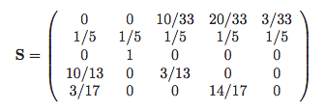
NFL Stochastic Matrix (S)
Nonnegative entries w/ each row summing to 1
The zero row in H corresponds to an undefeated season
A simple adjustment is converting the zero row to a row with entries equal to 1/n
This is the same as saying on game day the best team may lose to any other team with probability 1/n
This may not be ideal since 1/n is a significant number, given n ≤ 32
This could “penalize” the undefeated team
Code: Kenny; Images: Govan et al. 2008

Slide 28
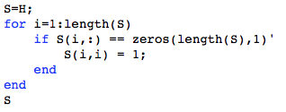
Alternative NFL Stochastic Matrix (S₂)
Instead of penalizing the undefeated team, an alternative adjustment is to put a 1 on the diagonal of the zero row
This is like saying the undefeated team only “votes” for itself
S₂ =
0 0 0.3030 0.6061 0.0909
0 1 0 0 0
0 1 0 0 0
0.7692 0 0.2308 0 0
0.1765 0 0 0.8235 0
The NFL2.m file uses this adjustment to create S
Code: Kenny; Images: Govan et al. 2008

Slide 29
Final Adjustments to the NFL Matrix
G= αS + (1-α)ev^{T}
v = personalization vector [0.2 0.2 0.2 0.2 0.2]
e = column of all ones
α = 0.85, determined experimentally
G =
0.0300 0.0300 0.2876 0.5452 0.1073 0.2000 0.2000 0.2000 0.2000 0.2000 0.0300 0.8800 0.0300 0.0300 0.0300 0.6838 0.0300 0.2262 0.0300 0.0300 0.1800 0.0300 0.0300 0.7300 0.0300
z₀ = [0.2 0.2 0.2 0.2 0.2]
lim_{k→ ∞} z₀G^{k} = π
(where π is the ranking vector)
π =
0.2494 0.2232 0.1827 0.2575 0.0872
(Car) (Pitt) (Chi) (TB) (NO)
Final Rankings: (1) Tampa Bay (2) Carolina (3) Pittsburgh (4) Chicago (5) New Orleans
Refer to NFL1.m file

Slide 30
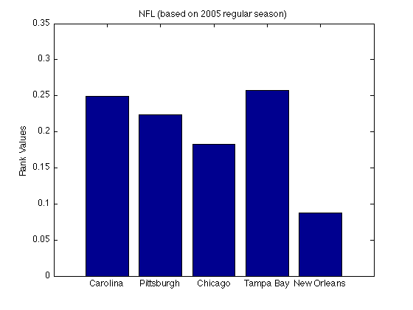
α = 0.85
RANKINGS
Tampa Bay
Carolina
Pittsburgh
Chicago
New Orleans
Refer to NFL1.m file

Slide 31
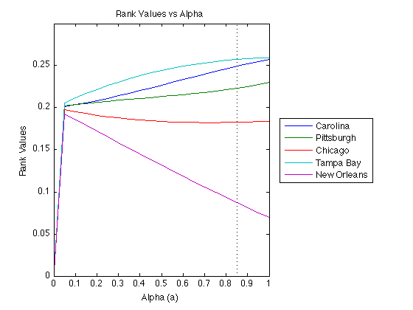
Refer to NFL_alpha.m file

Slide 32
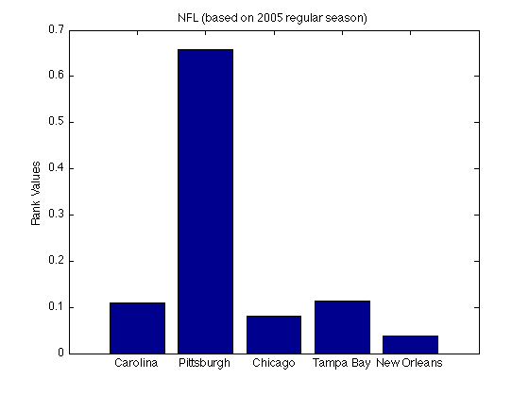
α = 0.85
*Alternative stochastic matrix (S₂) is used: undefeated team is not penalized
RANKINGS
Pittsburg
Tampa Bay
Carolina
Chicago
New Orleans
Refer to NFL2.m file

Slide 33
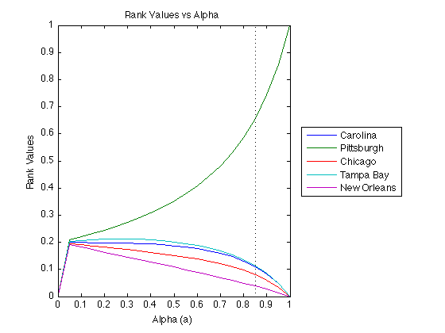
*Alternative stochastic matrix (S₂) is used: undefeated team is not penalized
Refer to NFL_alpha2.m file

Slide 34
Observations, Limitations, Changing Parameters
Accuracy of predictions increases as more games are played
Does not only take into account who won and lost, but also the margin of victories
But is a 30-20 game equivalent to a 10-0 game?
Scoring in “garbage time”, piling on the score when the game is meaningless can artificially make a team look much better than it is
If you only care about wins and losses and not margin of victories, use the Colley Matrix method (Colley 2002)
Changing parameters such as alpha, v and changing the method of adjusting H to stochastic matrix S can change your final rankings
Demonstrate w/ NFL1.m, NFL2.m, NFL3.m, NFL_alpha.m, NFL_alpha2.m
How should we choose our parameters?
Assumes teams are “static”, excludes injuries, suspensions, etc.

Slide 35
MLB, AL East Division Graph (as of 4/15/14)
2
4
TOR
NYY
4
8
2
4
4
5
2
3
2
7
1
1
9
1
1
6
4
TAM
BAL
BOS
1
1
Refer to MLB_415.m file

Slide 36
MLB, AL East Division Graph (as of 4/15/14)
6
TOR
NYY
4
10
4
3
7
12
2
1
10
6
5
TAM
BAL
BOS
1
Refer to MLB_415.m file
Notes:
Same as previous slide

Slide 37
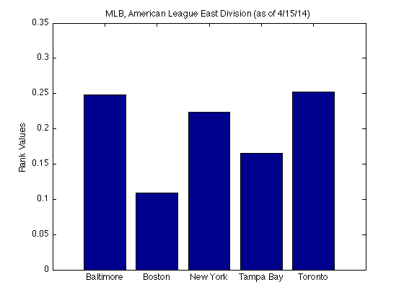
α = 0.85
RANKINGS
Toronto
Baltimore
New York
Tampa Bay
Boston
Refer to MLB_415.m file

Slide 38
MLB, AL East Division Graph (as of 4/16/14)
6
TOR
NYY
4
10
4
3
7
12
2
1
10
9
5
TAM
BAL
BOS
1
Refer to MLB_416.m file

Slide 39
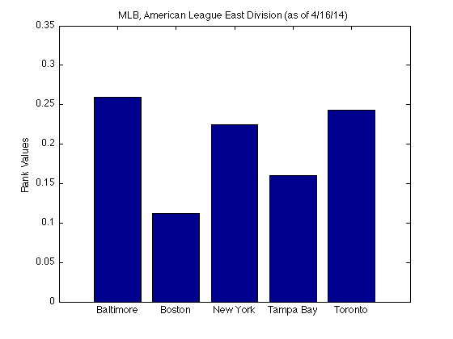
α = 0.85
RANKINGS
Baltimore
Toronto
New York
Tampa Bay
Boston
Refer to MLB_416.m file

Slide 40
MLB, AL East Division Graph (as of 4/17/14)
6
TOR
NYY
4
8
10
4
3
7
12
2
1
10
9
5
TAM
BAL
BOS
1
Refer to MLB_416.m file

Slide 41
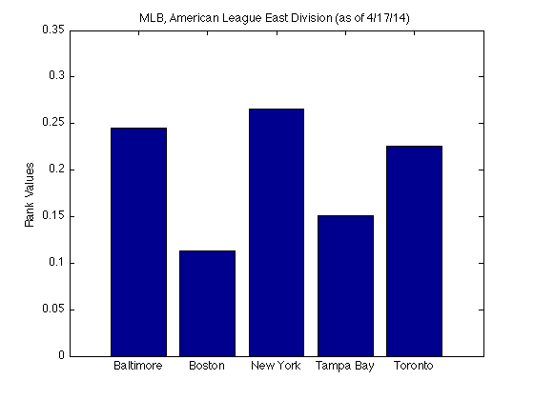
α = 0.85
RANKINGS
New York
Baltimore
Toronto
Tampa Bay
Boston
Refer to MLB_417.m file

Slide 42
MLB, AL East Division Graph (as of 4/18/14)
6
TOR
NYY
4
8
10
4
3
7
12
2
1
10
6
9
5
TAM
BAL
BOS
5
Refer to MLB_418.m file

Slide 43
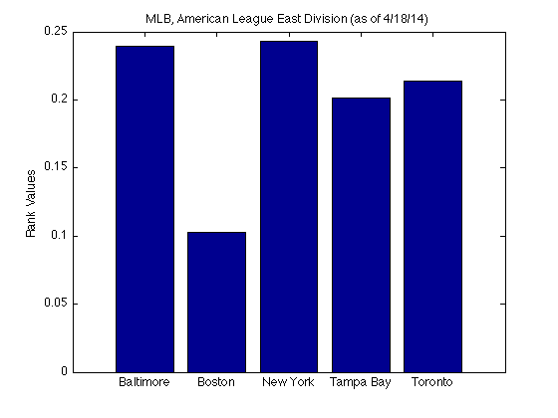
α = 0.85
RANKINGS
New York
Baltimore
Toronto
Tampa Bay
Boston
Refer to MLB_418.m file

Slide 44
MLB, AL East Division Graph (as of 4/19/14)
6
TOR
NYY
4
8
10
4
3
7
12
2
1
10
21
9
7
TAM
BAL
BOS
5
Refer to MLB_419.m file

Slide 45
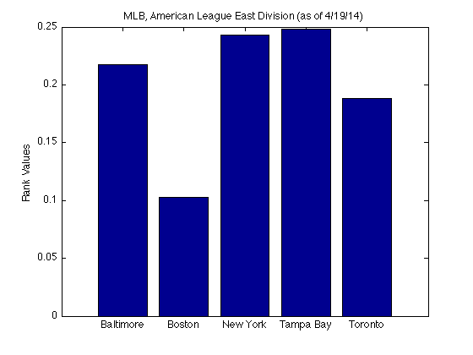
α = 0.85
RANKINGS
Tampa Bay
New York
Baltimore
Toronto
Boston
Refer to MLB_419.m file

Slide 46
MLB, AL East Division Graph (as of 4/20/14)
6
TOR
NYY
4
12
10
4
3
7
12
2
1
10
21
9
8
TAM
BAL
BOS
5
Refer to MLB_420.m file

Slide 47
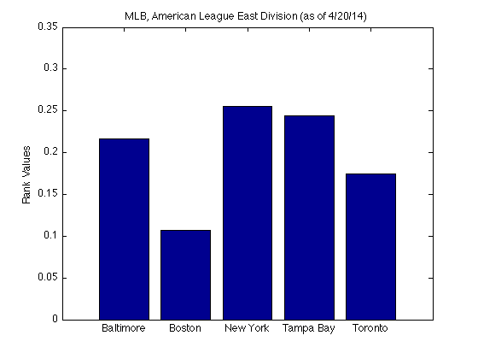
α = 0.85
RANKINGS
New York
Tampa Bay
Baltimore
Toronto
Boston
Refer to MLB_420.m file

Slide 48
MLB, AL East Division Graph (as of 4/21/14)
6
TOR
NYY
4
12
10
4
3
7
12
2
1
10
21
9
8
TAM
BAL
BOS
6
Refer to MLB_421.m file

Slide 49
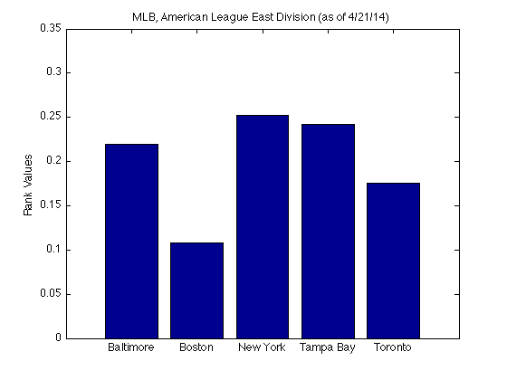
α = 0.85
RANKINGS
New York
Tampa Bay
Baltimore
Toronto
Boston
Refer to MLB_421.m file

Slide 50
MLB, AL East Division Graph (as of 4/22/14)
6
TOR
NYY
4
12
16
4
3
13
12
2
1
10
21
9
8
TAM
BAL
BOS
6
Refer to MLB_422.m file

Slide 51
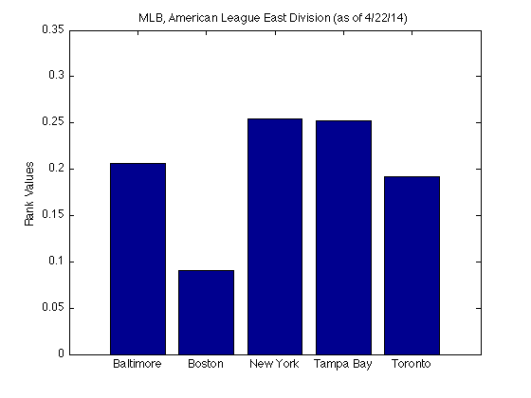
α = 0.85
RANKINGS
New York
Tampa Bay
Baltimore
Toronto
Boston
Refer to MLB_421.m file

Slide 52
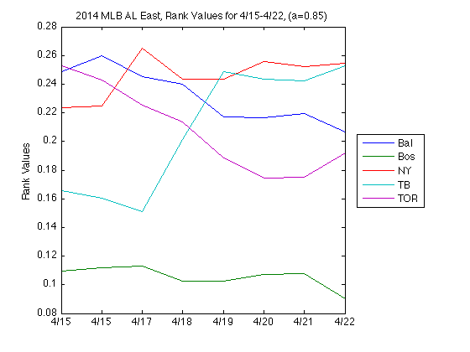
Actual W/L against AL East
1) NY: 9-6
2) TOR: 6-5
3) BAL: 8-8
4) BOS: 5-7
5) TB: 4-6
Refer to MLB.m file

Slide 53
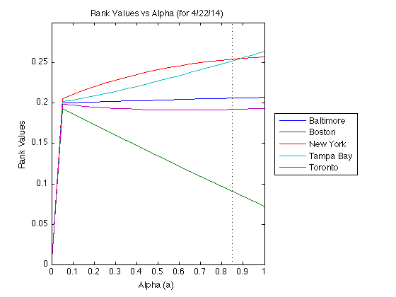
Refer to MLB_alpha.m file

Slide 54

Cambridge Econometrics, 2012

Slide 55
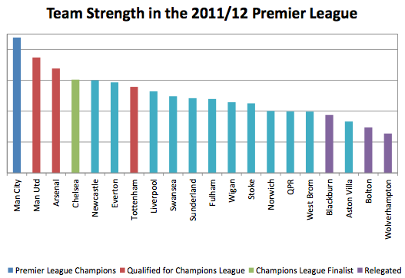
Teams in the blue box would have qualified for the Champions League using PageRank
Cambridge Econometrics, 2012
Notes:
Cambridge Econometrics

Slide 56
Key Takeaways
Used Google’s PageRank algorithm to rank sports teams by their relative strengths
It is a relatively simple algorithm to implement on MATLAB, only requiring a person to update their H matrix after each game
Nonetheless, no ranking method is perfect, as the PageRank model for sports teams can certainly be improved, especially given its assumptions and some of the arbitrary choice of parameters

Slide 57
MATLAB Code
Google.m %Computes page rank of 5 websites, α = 0.85
Google_alpha.m % Compares page rank vs alpha (α)
MLB.m %Executes MLB_415 to 422 and plots the rank values over that span
MLB_415.m %Computes team rank of MLB AL East Division as of 4/15/14
MLB_416.m % “ “ as of 4/16/14
MLB_417.m % “ “ as of 4/17/14
MLB_418.m % “ “ as of 4/18/14
MLB_419.m % “ “ as of 4/19/14
MLB_420.m % “ “ as of 4/20/14
MLB_421.m % “ “ as of 4/21/14
MLB_422.m % “ “ as of 4/22/14
NFL1.m %Computes team rank of 5 NFL teams, α = 0.85
NFL2.m % “ “, α = 0.85, using alternative adjustment for stochastic matrix (S₂)
NFL3.m % “ “, α = 0.85, personalization vector is different
NFL_alpha.m % Compares team rank vs alpha (α)
NFL_alpha2.m % “ “, using alternative adjustment for stochastic matrix (S₂)
PowerMethod.m %Power method to determine dominant λ and its eigenvector
test_PM %Test power method function on google matrix from Google.m

